Slide 1
Business Ties
Knots among the top 100 US publicly traded companies

Slide 2
Agenda
Introduction
Data
Analysis
Conclusions
Notes:
Anees

Slide 3
Introduction
What is a Board of Directors?
What are the requirements to be on the Board of Directors?
Where are there conflicts of interest?
Notes:
Anees
Elected group that is supposed to represent shareholders. Every public company must have a board of directors
Hiring and firing of execs. Dividend policies. Exec compensation
Can be dismissed for conflicts of interest and using info not for companies benefit or insider trading
Don’t have to be a shareholder but often compensated that way

Slide 4
Introduction
Fortune 100
Avg CEO compensation: $18.4M
Percent of Market
Notes:
Anees

Slide 5
Data
Walmart
Exxon Mobil
Apple
Berkshire Hathaway
Amazon.com
UnitedHealth Group
McKesson
CVS Health
AT&T
AmerisourceBergen
Notes:
Anees
Talk about how different industries are represented
Many household names

Slide 6
Descriptive Stats
19.91 Executives per company
11.68 Board Members per company
Notes:
Anees
Senior management team includes exec and senior VPs

Slide 7
Two Graphs
Company to People
Company to Company
Notes:
Chen

Slide 8
Constructing the Graph (Company to People)
Nodes
1. People
2. Companies
Edges
1. Company to Member of BOD
2. Company to Executive Management
Notes:
Chen

Slide 9
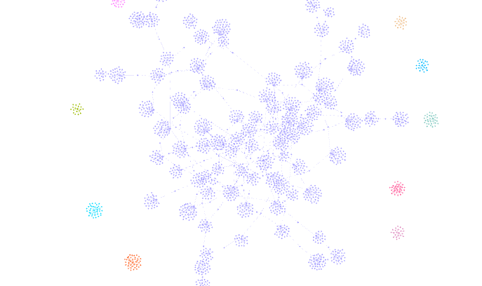
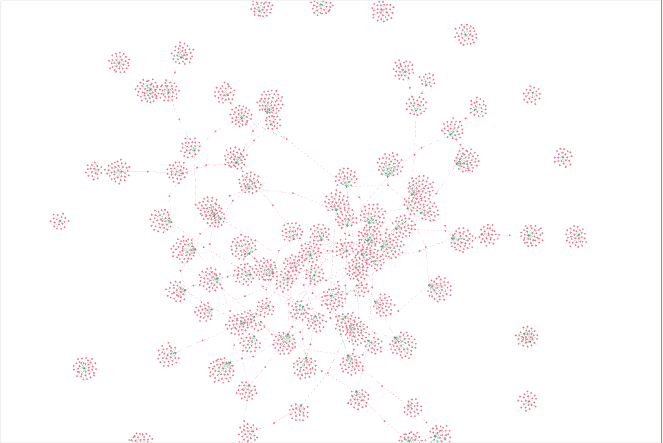
Visualization (Company to People)
Nodes: 2947
Edges: 3159
By Node Type
By Connected Component
Notes:
Anees
Large connected component
Green is company, red is people

Slide 10
Constructing the Graph (Company to Company)
Nodes
Companies
Edges
Weighted by the number of people that are shared between two companies across executive management team and board of directors
Notes:
Chen

Slide 11
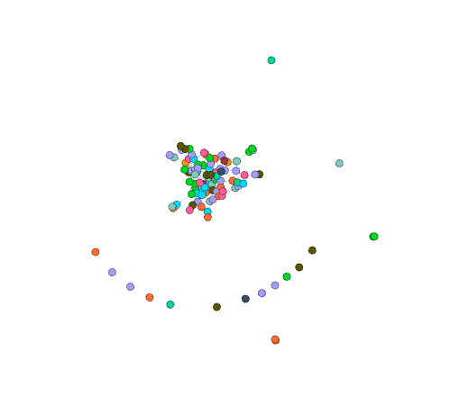
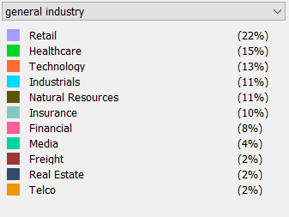
Visualization (Company to Company)
Nodes: 100
Edges: 160
Notes:
Anees

Slide 12

Analysis
Notes:
Chen

Slide 13
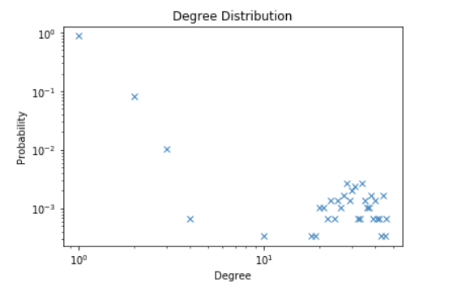
Degree Distribution (CP)
Notes:
Chen

Slide 14
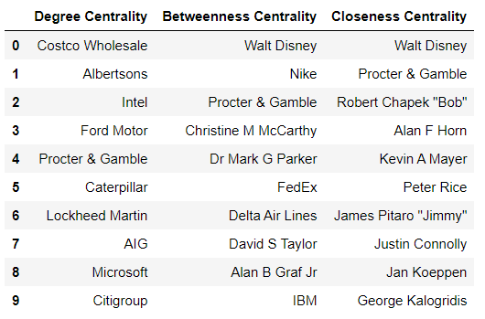
Centrality (CP)
Average Degree = 2.144
Notes:
Chen
McCarthy is on P&G board, senior exec for Disney,
Parker is Nike CEO, Disney and Nike board

Slide 15
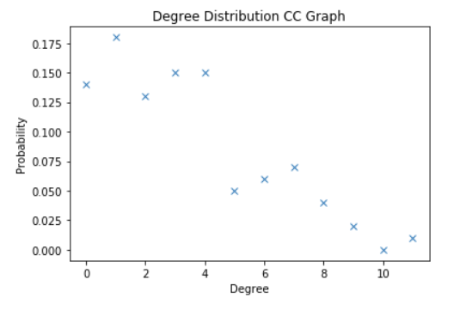
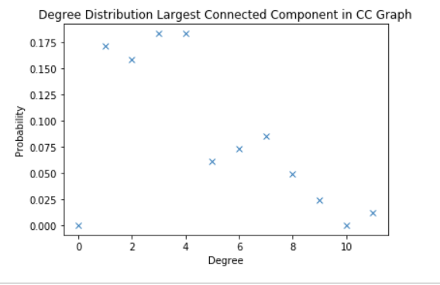
Degree Distribution (CC)
Notes:
Anees
No more nodes with degree 0. Nodes with degree 1 through 4 constitute higher percentage of nodes

Slide 16
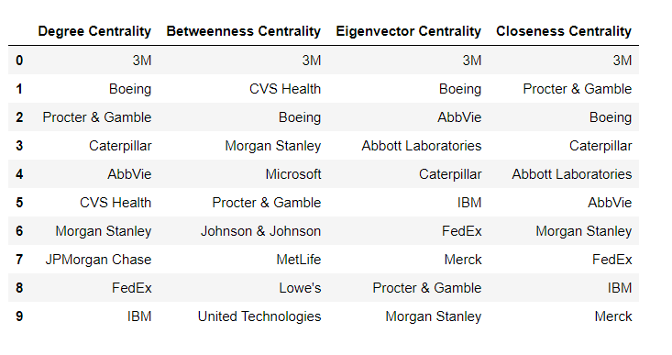
Centrality (CC)
Average Degree = 3.2 Average Edge Weight = 1.256
Notes:
Anees
3M tops all centrality measures
Average Edge weight is pretty low

Slide 17
Deeper Dive on 3M
 | Exec Membership | Board Membership
Michael F Roman | 3M
Michael L Eskew "Mike" |  | IBM, Allstate
Edward M Liddy "Ed" |  | Abbvie, Abbott Labratories, Boeing
Herbert L Henkel "Herb"
Muhtar Kent
Thomas K Brown "Tony"
David B Dillon "Dave"
Gregory R Page "Greg" |  | Deere
Patricia Ann Woertz |  | P&G
Amy E Hood |  | Microsoft
Dr Dambisa F Moyo |  | Chevron
Pamela J Craig "Pam" |  | Progressive, Merck
Notes:
Anees
Lots of people on other boards -> interconnected

Slide 18
Conclusions
Fortune 100 are quite connected
Connections are not industry specific => Exec members try to be on boards of companies in other industries
Notes:
Anees
Quite connected
But not heavily connected (avg edge weight in CC is only 1.25)

Slide 19
Future Considerations
Larger dataset (Fortune 500)
People to People graph
Look at characteristics of people more (experience in position, previous experience on boards/exec, education)
Notes:
Chen

Slide 20
Questions?

